Slide 1
IoT anomaly detection
Rashi Pachino
Noah Weiss
Github:
Dataset:

Slide 2
Team
Rashi Pachino
345174478
Noah Weiss
326876786

Slide 3
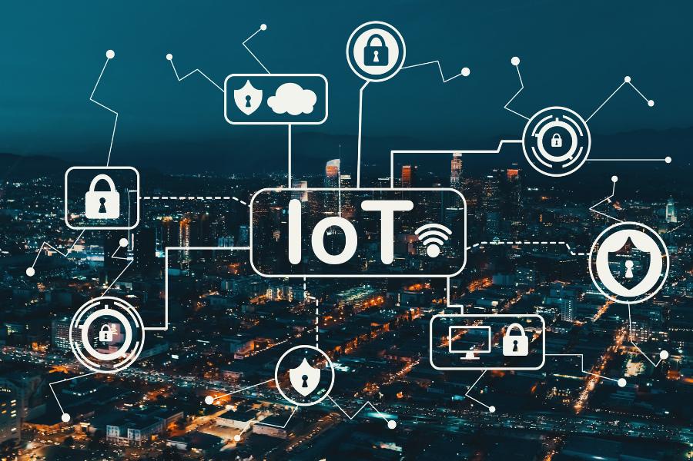
Agenda
Background
Prior Work
The Dataset
Our Model
Results

Slide 4
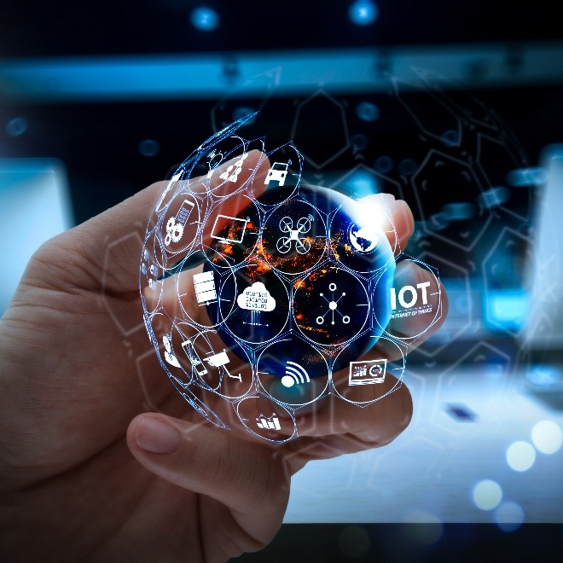
Background
The Internet of Things (IoT) - budding network of interconnected physical devices, home appliances, vehicles and even people
Each ‘thing’ is provided with unique identifiers and do not require human-to-human or human- to-computer interaction to transfer data.
Integration between the physical world and communication networks and its application in the environment we live in
ML strategies for IoT protection have advanced considerably in recent years

Slide 5
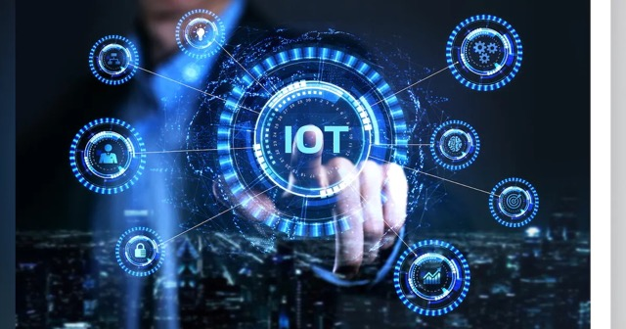
Prior Work
Assembled Supervised - Random Forest (RN), K-Nearest-Neighbors (KNN), and Naïve Bayes - Al-Akhras et al.
UNSW-NB15 dataset
100% accuracy
Unsupervised - Abusitta Neural Network (DNN) - Apostol et al.
DS2OS traffic traces dataset
94.6 % accuracy

Slide 6
The dataset
UNSW-NB15

Slide 7
The Dataset
Tcpdump tool used to capture 100 GB of raw traffic (Pcap files)
12 algorithms used to form 49 features
Features include
Source and destination IP addresses
Source packets retransmitted or dropped
Destination packets retransmitted or dropped
Transaction protocol
Etc.
175,341 records
80% training, 20% testing
9 types of attacks :
Fuzzers
Analysis
Backdoors
DoS
Exploits
Generic
Reconnaissance
Shellcode
Worms

Slide 8
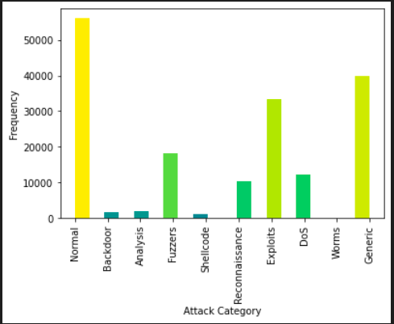
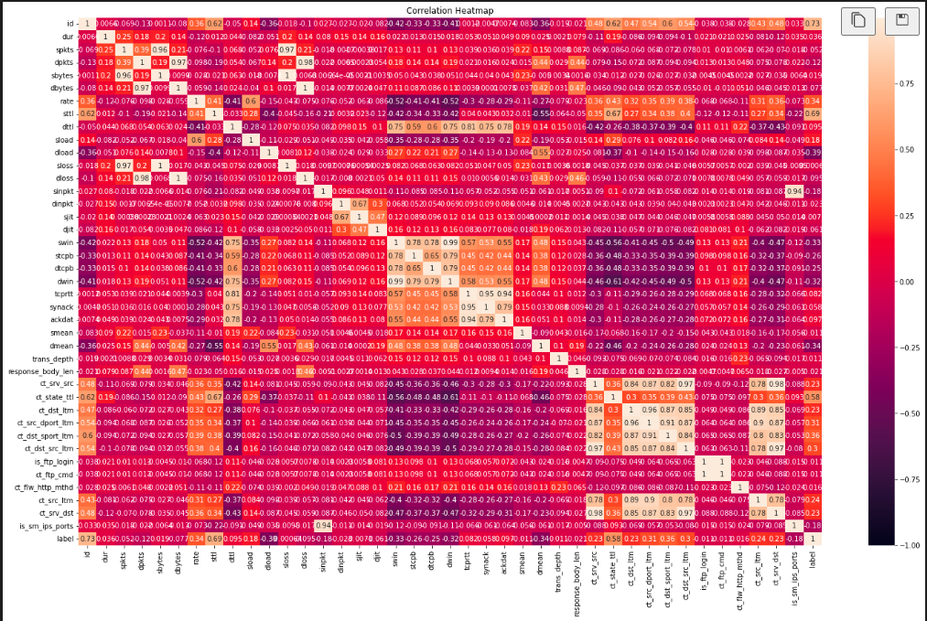
Dataset Charts

Slide 9
Our Model
Autoencoder, Random Forest, KNN, XGBoost Ensemble

Slide 10
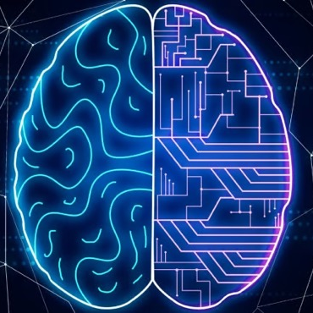
Our Model
Label Encoder to encode data as numerical features
Autoencoder Preprocessor to lower dimension space
Random Forest, XGBoost and KNN Classifiers
Voting Algorithm between the three

Slide 11
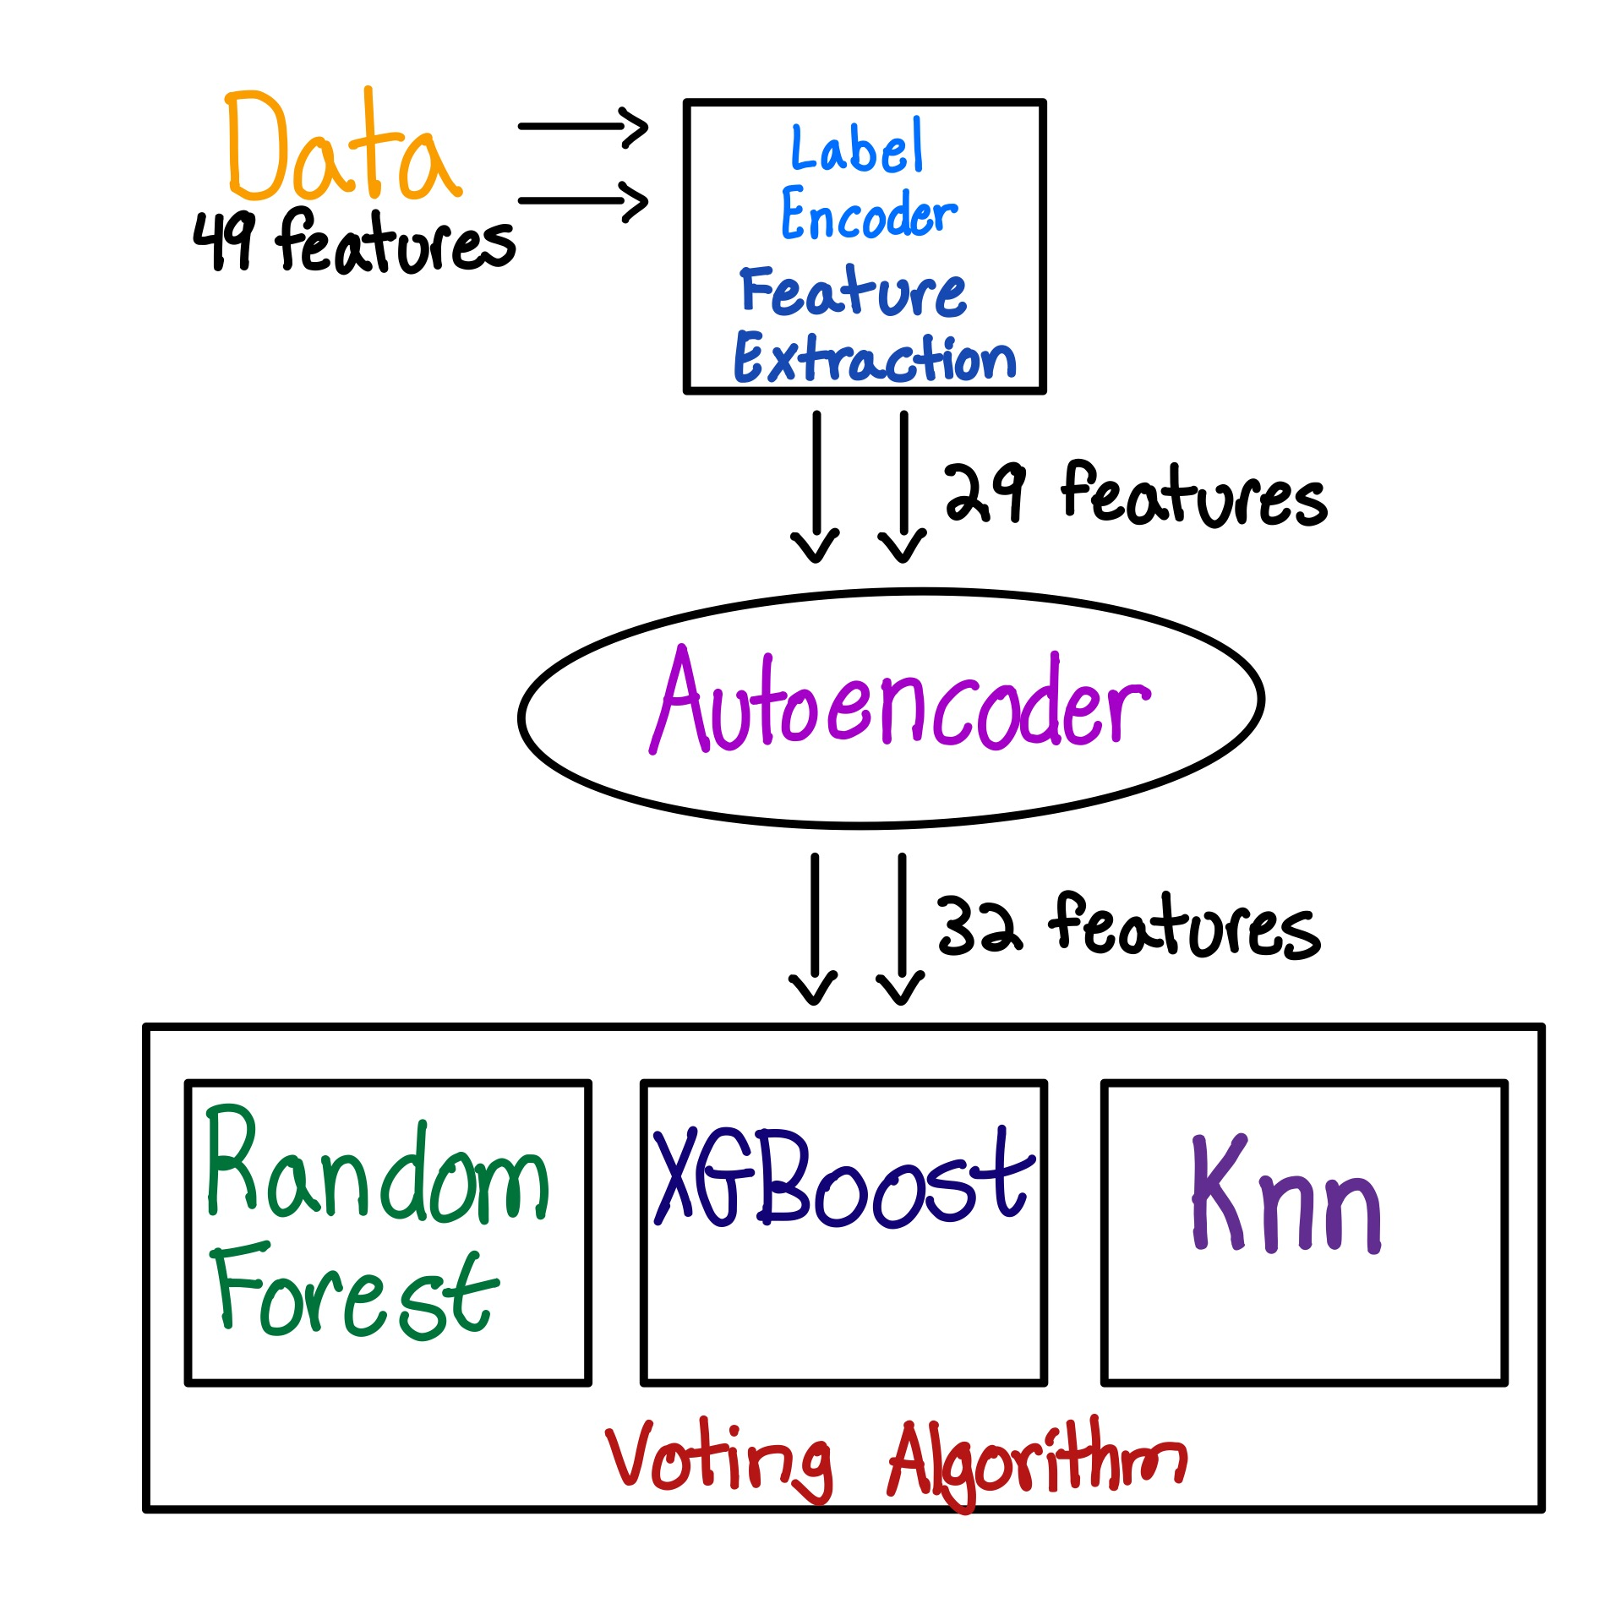

Slide 12
Confusion Matrix
 | Predicted Normal | Predicted Malicious
Normal | 10443 | 726
Malicious | 138 | 23762

Slide 13
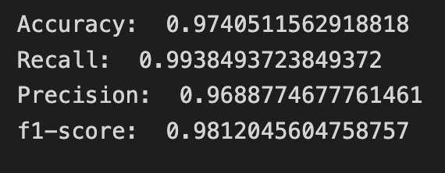
Results

Slide 14
Prior Work Comparison
 | Accuracy | Recall | Precision | F1-Score
Our Model | 97 | 99 | 97 | 98
Voting of RF, KNN, Naïve Bayes | 99.5 | Was not mentioned | Was not mentioned | Was not mentioned
DNN | 95 | Was not mentioned | Was not menntioned | Was not mentioned
References:
1. Link
2. https://www.sciencedirect.com/science/article/pii/S2542660522001378

Slide 15

Demo

Slide 16
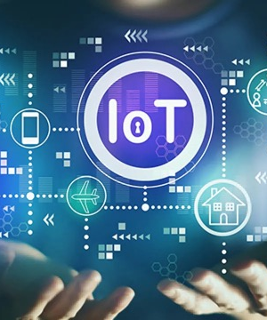
Future Work
Attack category detection
Updated Data (NB-15 is from 2015)

Slide 17




Thank you
Rashi Pachino
Noah Weiss
Github:
Dataset:

